Slide 1
Untitled Survival Game
A project by
Rafi Hassan Chowdhury 190041234
Syed Fateen Navid Haider 190041226
Zaed Bin Monir Atib 190041236
Mahmudur Rahman 190041206

Slide 2
Part 1:
The Idea

Slide 3
We borrowed many elements from several genres. Survival and maze-solving are tied together - both you have to achieve in a limited time in order to win.
Genres?
We don’t have a single phrase answer

Slide 4
Pure 3D - we used OpenGL and several third party libraries to achieve this
Voxel world - everything in the game is understood in terms of voxels
First-person perspective - necessary to deliver a fully immersive experience
Graphics
Where most of our budget went to

Slide 5
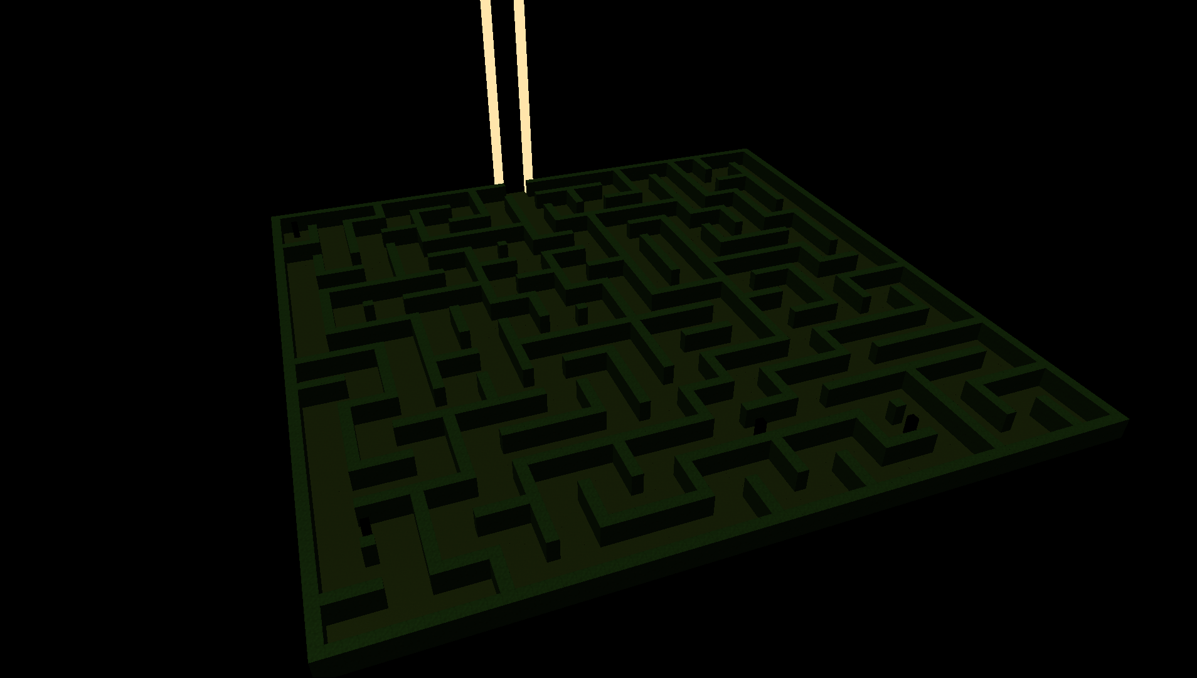
Mechanics
The Game World
64 x 64 voxel world with a skybox
Playing field is a procedurally generated maze - we used a modified randomized depth-first search algorithm for this
Somewhere inside which is your spawn location
What remains between you and the end are the maze itself and its residents who for the most part prefer to stay asleep
Caution is your ally as these creatures are highly sensitive to sound, touch, and light
To add to your inconvenience - you only have about 30 seconds before sunrise at the start of every game

Slide 6
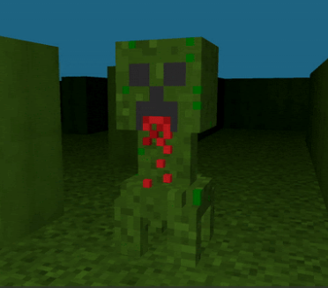
Mechanics
The Enemy
Inactive in absence of sunlight, sound, and touch
Activates and takes on the role of a hostile pursuer of the player in contact with those stimuli
Is capable of triggering game over scenario when caught up with the player in this state
Can track player from anywhere in the maze when in this state given that player is in its range - this is achieved using the A* algorithm

Slide 7
Mechanics
The Player
?
The game gives you all the tools to succeed. But be careful - every tool in your arsenal comes with caveats.
For instance, sprinting and jumping produce sound which in turn activates the maze’s hostile residents - and yet, sprinting can help you survive just a little longer for you to outrun any chasers and jumping to take a peek over what’s ahead of you can save some of your valuable time.

Slide 8
Part 2:
Implementation

Slide 9
Rendering

Slide 10
Shaders
Textures
Base

Slide 11
Programs that rest on the GPU
Run for specific part of Graphics pipeline
Originally used for 3D scenes
Transform data from CPU to GPU
Have data types like other language. Ex:int, double, vecn etc
Shaders

Slide 12
Vertex Shader that receive inputs
Fragment Shader that generate outputs color
Ins and Outs

Slide 13
Vertex Shader Fragment Shader
Receives vertex data as inputs
Define how data is organized
Transfer data to Fragment Shader
Receives data from Vertex Shader
Do necessary stuffs as user wants
Send output color buffer to GPU

Slide 14
GLSL Code Example
Vertex Shader
Fragment Shader
#version 330 core
layout (location = 0) in vec3 verPos;
out vec4 vertex_Color;
void main()
{
gl_Position = vec4(verPos, 1.0);
vertex_Color = vec4(1.0, 0.0, 0.0, 1.0);
}
#version 330 core
out vec4 frag_Color;
in vec4 vertex_Color;
void main()
{
frag_Color = vertex_Color;
}

Slide 15

Rendering a triangle using shader

Slide 16
Load Shader
Check for shader compilation error
Set characteristic of loaded shader
Shader Class

Slide 17
A 1D, 2D or 3D image
A piece of coating that gives visual beauty to an object
Gives illusion of any object
Texture

Slide 18
Mesh

Slide 19
Collection of vertices,edges and faces
Can store texture coordinates
Describe shape of a 3D object
Structure of a model
Definition

Slide 20
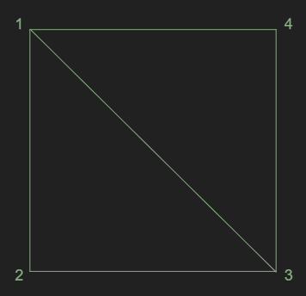
Visual
Every triangle here is a mesh
2 mesh together representing a face
Collection of mesh will represent a model or polygon

Slide 21
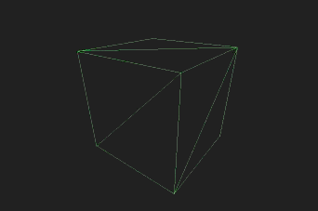
Voxel using mesh

Slide 22
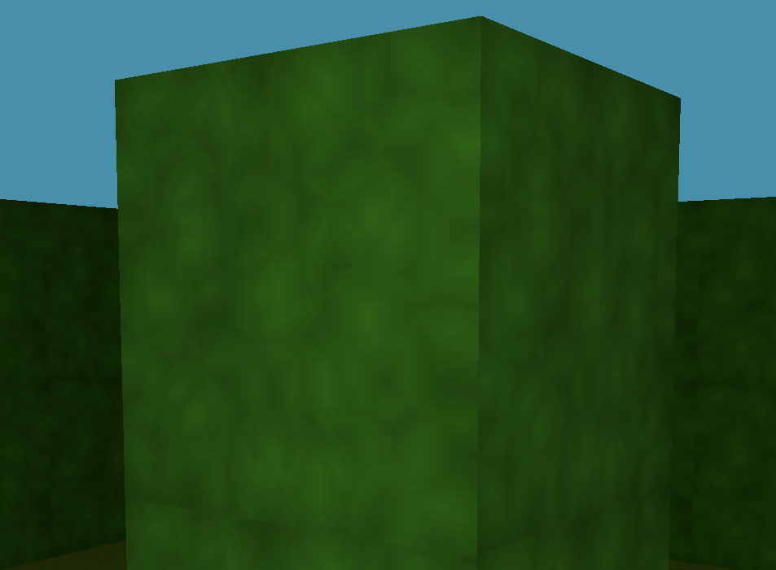
Texturing on Mesh
Mesh will create a face
Face coated with texture gives an illusion of real life object

Slide 23
Store vertex data
Store index data
Store texture coordinates
Initialize buffer objects or array
Render the mesh
Mesh Class

Slide 24
Model

Slide 25
Mathematical representation of any object
Collection of mesh , nodes, material and textures
Create illusion to represent real-life object structure
Definition

Slide 26
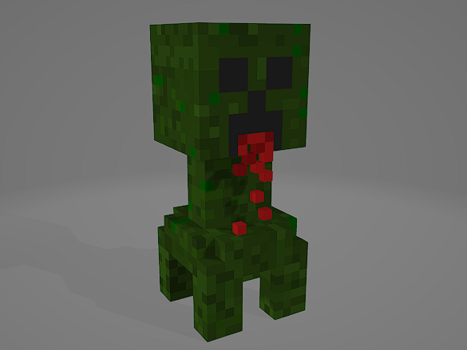
Use of Models
Collection of mesh will represent a model or polygon
Visual representation of Player
Visual representation of Enemy
Representation of gaming environment

Slide 27
Store Textures data
Store Materials data
Store meshes data
Store colors data
Import models into OpenGL
Process Nodes and Meshes
Draw all meshes and render the object using shader
Model Class

Slide 28
Camera

Slide 29
Work like eye or view of Player
Give illusion of moving around in an environment
Transform all worlds coordinates into view coordinates
Definition

Slide 30
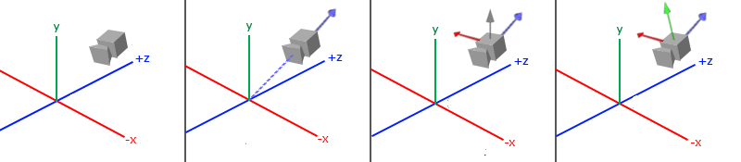
View space
(9,10,2)
(0,1,0)
(0,0,0)
(0,0,0)
(0,0,0)
(0,0,0)
1. Position
2. Direction
1.Right
1. Up

Slide 31
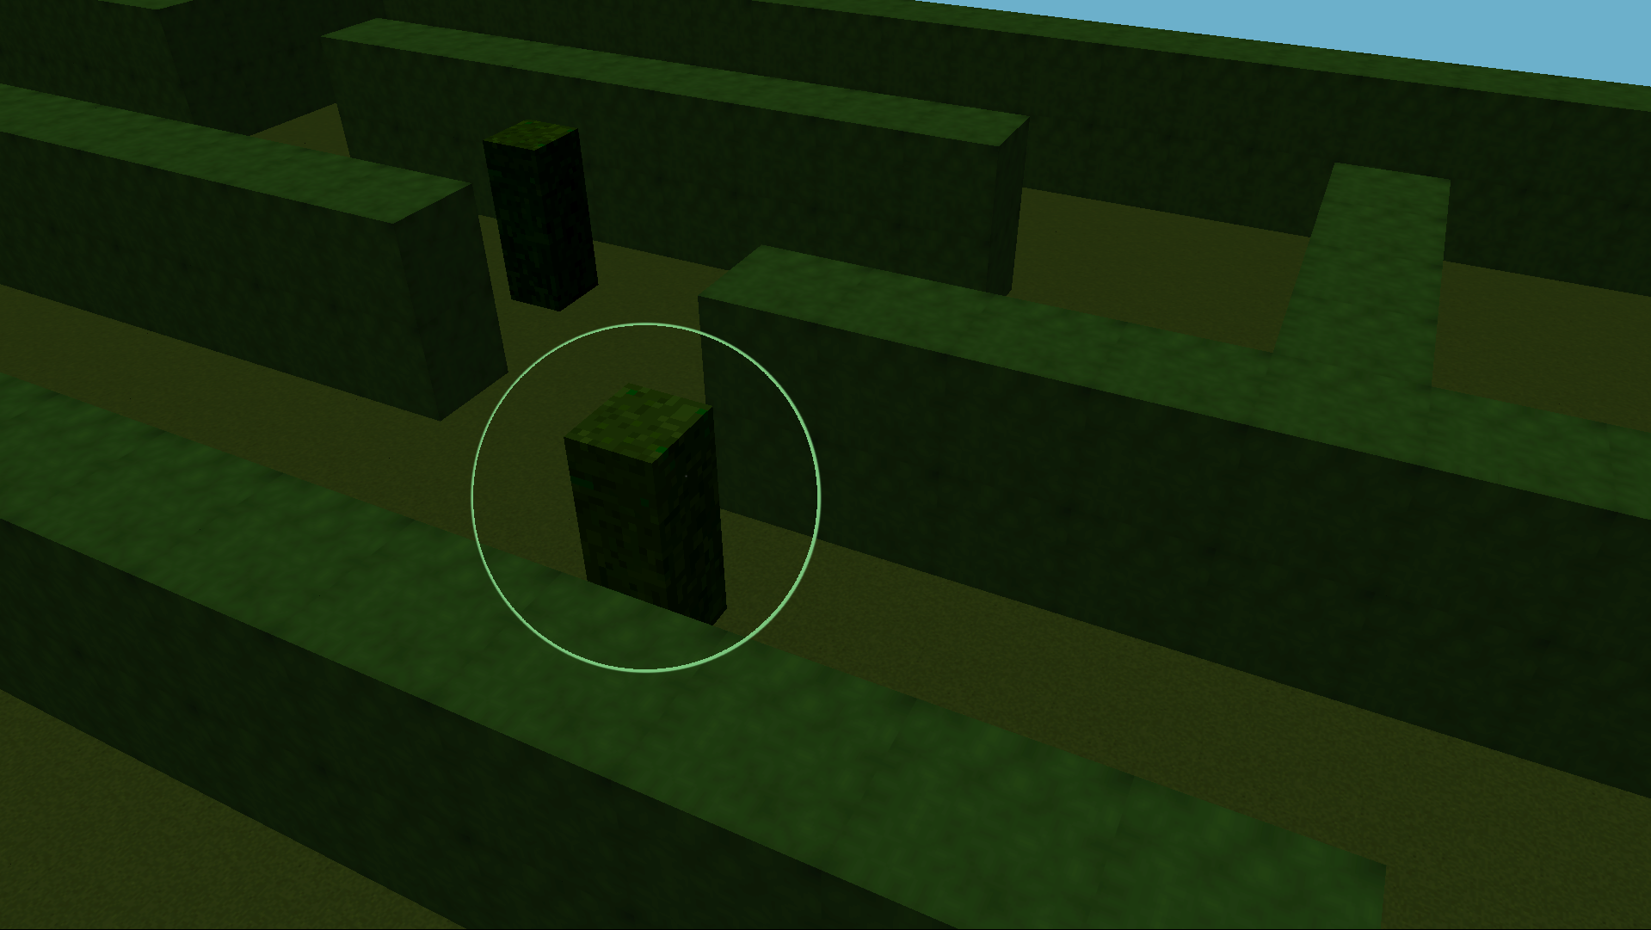
Camera
Position
A 3D vector in 3D space
Locate where the view is now in world space
Vector3(x,y,z) store the data of position

Slide 32
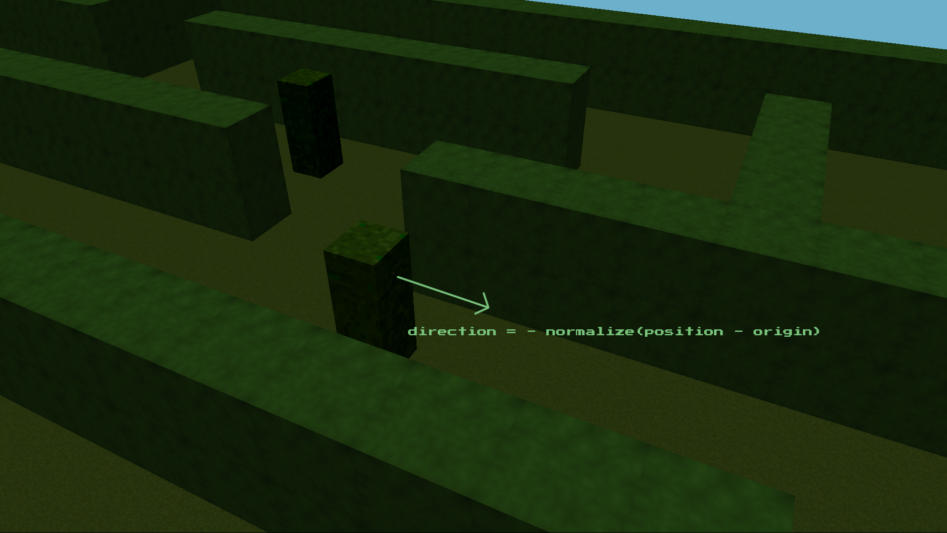
Camera
Direction
A 3D vector in 3D space
Locate where the view is now in world space
Direction is reverse of normalize value of (position - space_origin)

Slide 33

Camera
Right
Represent positive x-axis of camera space
right = normalize
(
cross((0,1,0),direction)
)

Slide 34
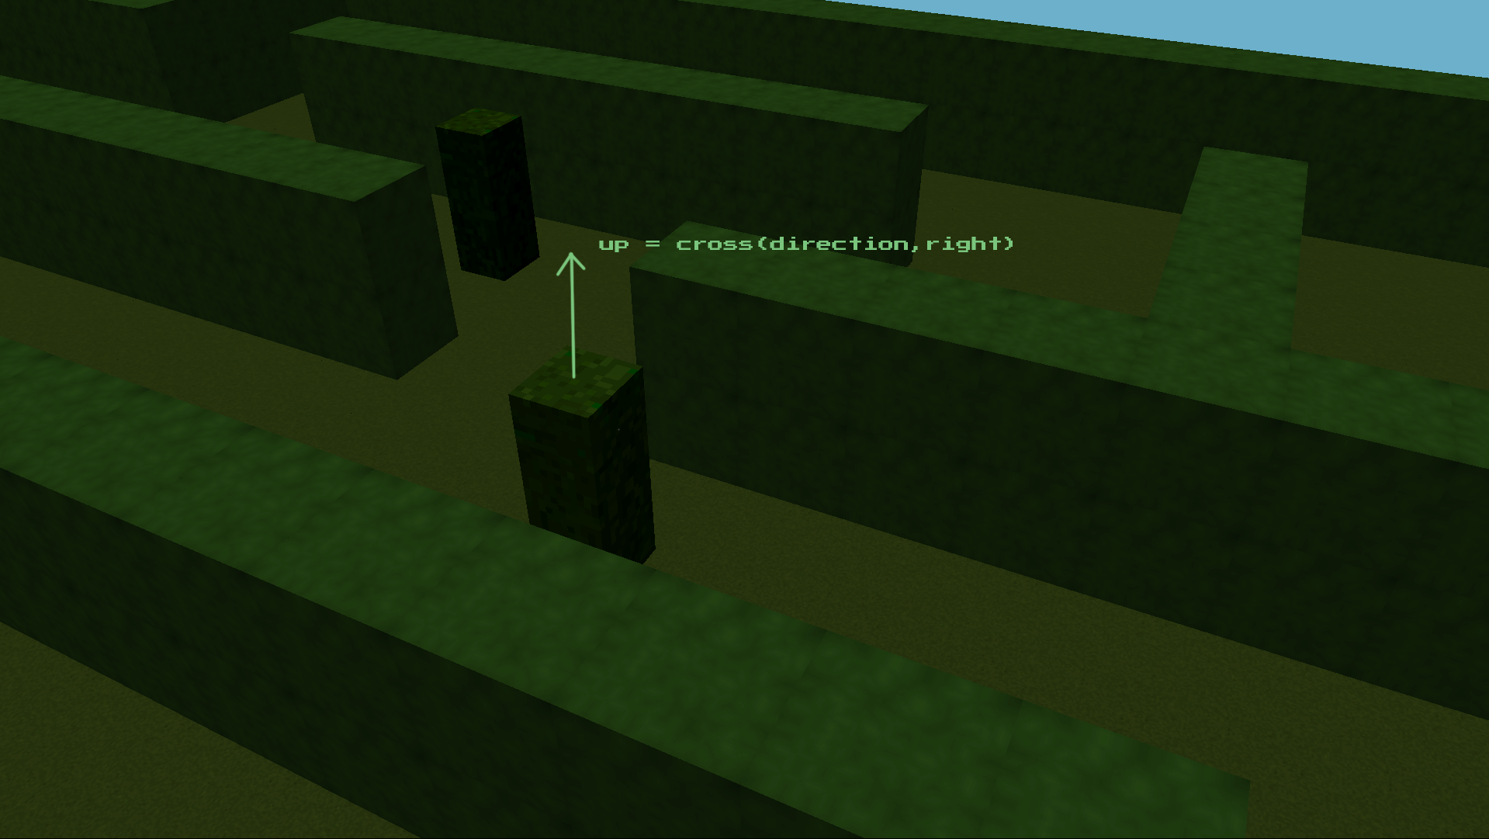
Camera
Up
Represent the Position y-axis of camera space
Up = cross(direction, right)
Gram-Schmidt process was used here for ortho-normalizing these sets of vectors

Slide 35
Create view matrix that transform coordinates in an eye view of player
Look At

Slide 36
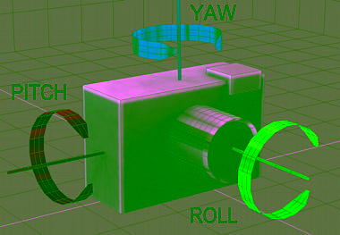
Camera
Angles
Pitch is rotation on x-axis like head looking at legs to sky
Yaw is rotation on y-axis like looking around left to right
Roll is rotation on z-axis

Slide 37
Store required variables to process camera
Process right,up, direction vectors according to user inputs
Give an illusion of moving around
It is attached with player in parallel
Camera class

Slide 38
Maze Generation

Slide 39
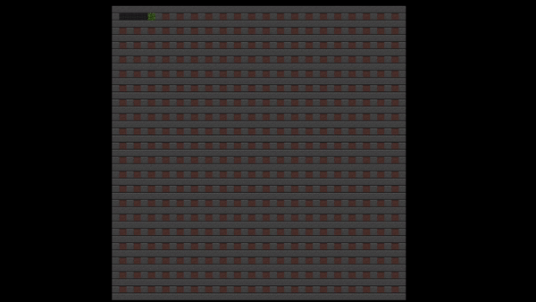
Iterative implementation was used instead of the recursive one for performance.
Generates random mazes for every new game.
The random engine (std::mt19937) was seeded with std::random_device and passed to an instance of std::uniform_real_distribution for every call.
The base algorithm was modified enabling the maze to have loops.
Algorithm
Randomized depth-first search

Slide 40
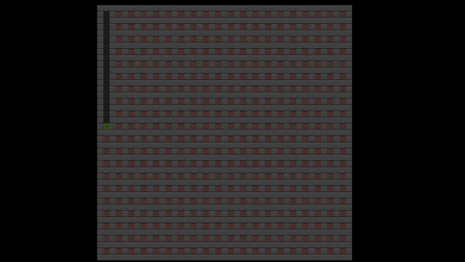
Random engine may give the same sequence of numbers every time if called with the same seed every time.
This is bad for maze generation as the maze loses its identity and difficulty.
And so, this was carefully avoided.
Pitfalls
Results of a Bad Seed

Slide 41
Generate Seed
Generate random maze every time
Manipulate maze to make complex
Maze class

Slide 42
Hedge

Slide 43
An unit of maze
Have collider
Make visual representation of Maze
Definition

Slide 44
Store model
Store shader
Store Maze Data
Store model matrices (increase efficiency) and create instance
Initialize required datas
Store colliders data
Update with time
Hedge Class

Slide 45
A hedge
Our maze will be a collection of hedges and they will be set on maze according to maze data generated by random maze generator

Slide 46
Our 3D Maze

Slide 47
Entity

Slide 48
Base of any object
Give structure to any object
Holds basic informations
Definition

Slide 49
Store shader
Store model
Store object transform coordinates
Render the shape
Entity Class

Slide 50
Player

Slide 51
Main part of game
User controlled
Definition

Slide 52
Can move around
Can light a torch
Can jump
Give response to collision
Functionality

Slide 53
Store necessary datas
Update position with user inputs
Connected with camera in parallel
Player Class

Slide 54
Input Process

Slide 55
Connect input device
Does necessary works according to user interaction
Control player object as like as command
Functionality

Slide 56
Keyboard
Mouse
Gaming Controller
Input Device

Slide 57
A,S,D,W for movement
F for torch
Space for jump
Shift for sprint
Mouse for looking around
Keyboard & Mouse

Slide 58
Left axis and arrows for movement
Right axis for looking around
RB for sprint
LB for torch
Controller

Slide 59
Connect player and gammer
Store inputs devices
Response according to inputs command
Input Class

Slide 60
Collision

Slide 61
Forceful interaction of two or more bodies
Have after effect
Helps objects not to go through any other hard objects
Definition

Slide 62
Sphere-Rectangle collision
Sphere-Sphere collision
Category

Slide 63
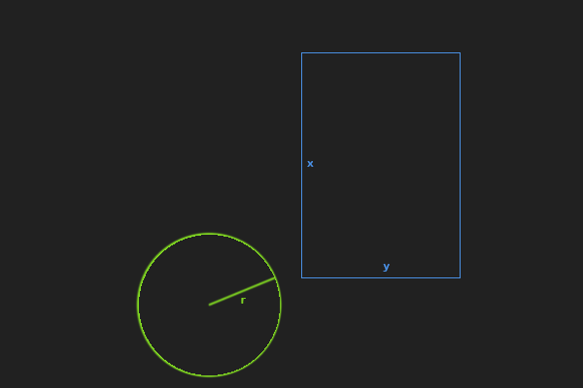
Collision Detection
Sphere-Rectangle
Ours one is in 3D space
Calculate the center and Rectangle sides to check collision
Response to the collision

Slide 64
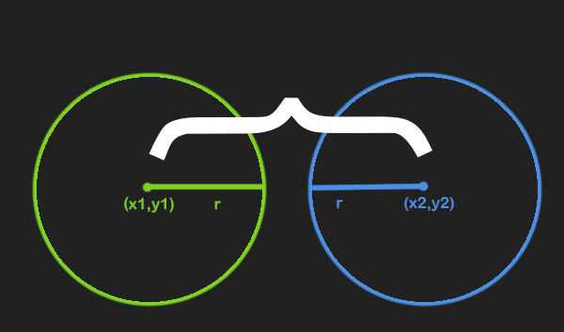
Collision Detection
Sphere-Sphere
Ours one is in 3D space
Calculate the center distance of 2 Sphere
Response to the collision

Slide 65
Add collider to objects
Response to collision as required
Make environment more realistic
Collision Class

Slide 66
Enemy

Slide 67
Opponent of player
After activation pursue player and impasse not to escape
Has AI to pursue player
Has animation
Characteristics

Slide 68
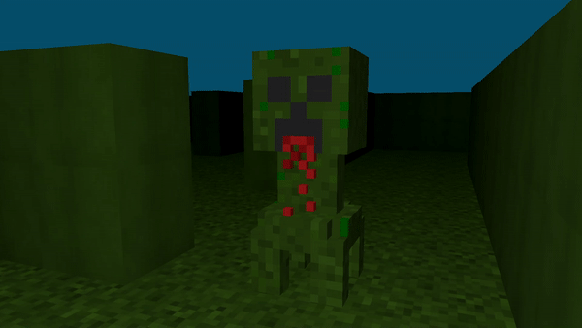
Visual look

Slide 69
Sleeping mode
Awake on noise, lights and day lights
Works to guard the maze
Functionality

Slide 70
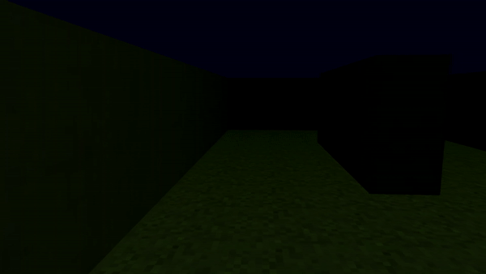
On awake
Transformation
At first looks like hedge
On awake change looks
Pursue player
Kill player on mella attack

Slide 71
Store enemy datas
Store enemy model and animation
Update on time
Render on screen using Shader
Store player and maze infos
Hold the A* Algorithm class and update on time
Enemy Class

Slide 72
Enemy AI

Slide 73
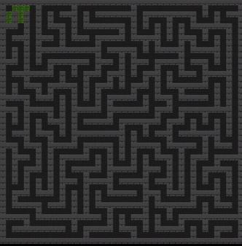
Algorithm
A* Search
Faster
Accurate
Perfect for games
Less space and time complexity O(b^{d})

Slide 74
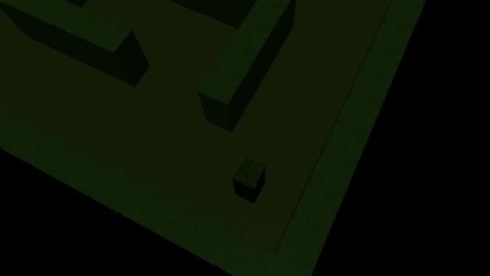
Enemy Roaming

Slide 75
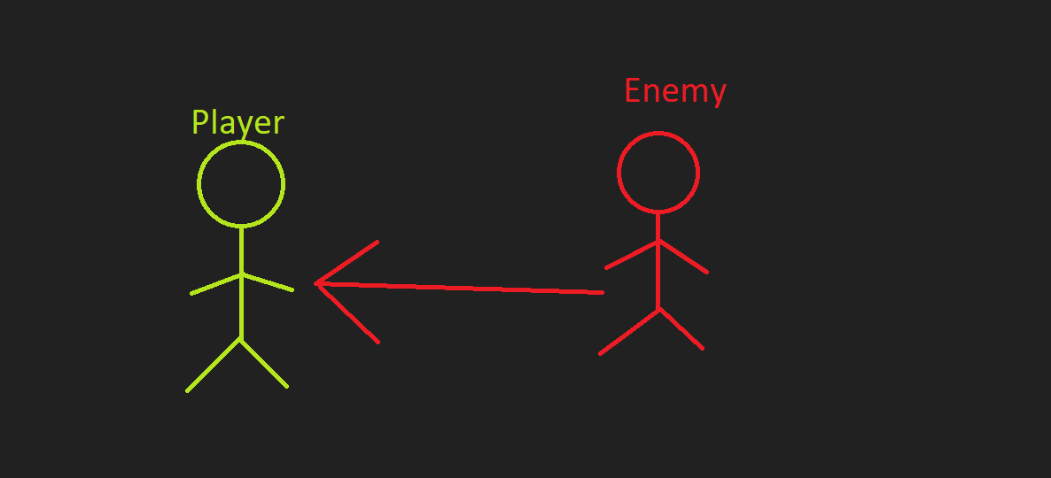
Relation
Player & Enemy
Enemy has player pointer
Can access player position data
Can chase player in real-time

Slide 76


Pursue
Enemy->Player
Player position change environment datas
Enemy track environment data to get path
On player & enemy collision player die

Slide 77
Make graphs using maze datas
Evaluate path for enemy using player data and maze data
Helps enemy to reach player in shortest way
A* & Node Class

Slide 78
Animation

Slide 79
Animation
Cyclic loop of models

Slide 80
Store model in sequential series
Load these models
Animation Class

Slide 81
Lights

Slide 82
Make realistic viewing
Make visual representation more related to game environment
Dynamically update according to lights positions
Functionality

Slide 83
Point light
Direction light
Torch light
Category

Slide 84
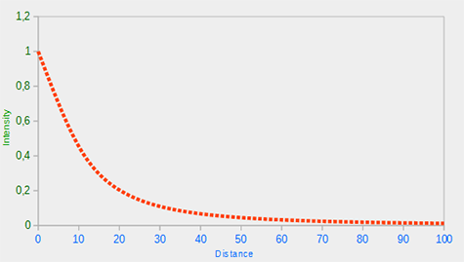
Depth change according to position
Attenuation
Reduce intensity with distance
Depends on source color
Mathematical values represents exponential graph

Slide 85
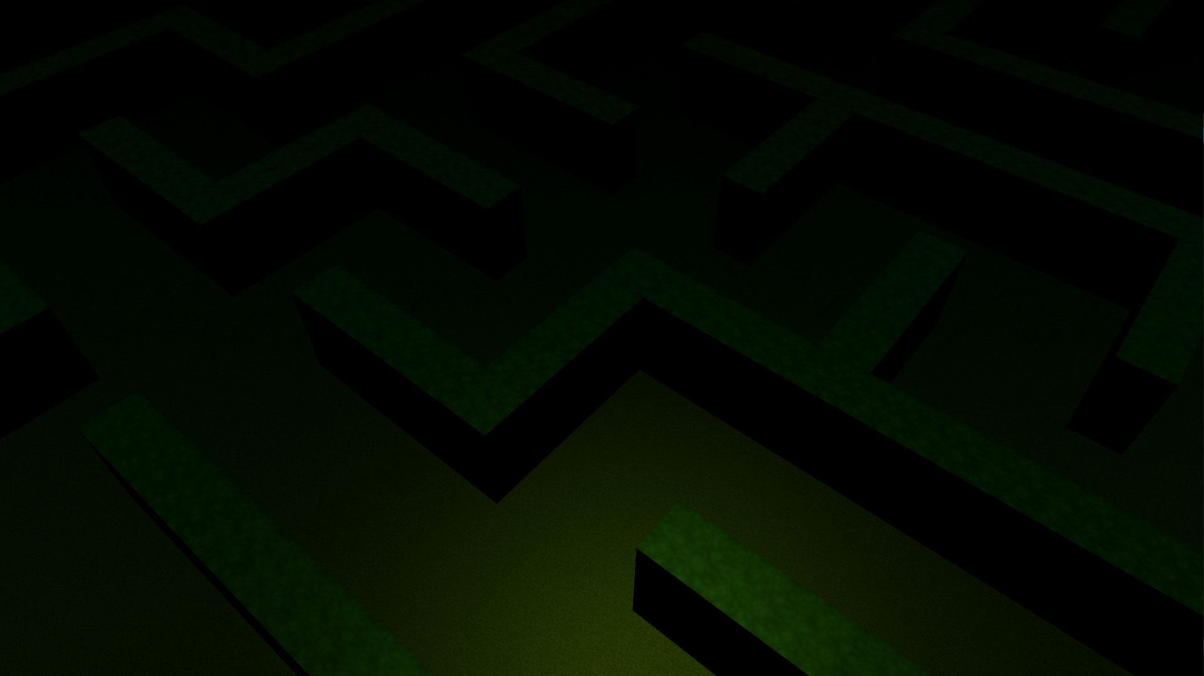
Example

Slide 86
Set lights positions
Manipulate environment according to shader
Set and execute light effects
Render light cubes on positions
Light Class

Slide 87
User Interface

Slide 88
Main Menu
Controls details
Credits
Shows current state
Helps player to interact and visualise current state of pre game environment
Necessity

Slide 89
Load Models and Store models
Render on screen
respond to user input
Button class

Slide 90
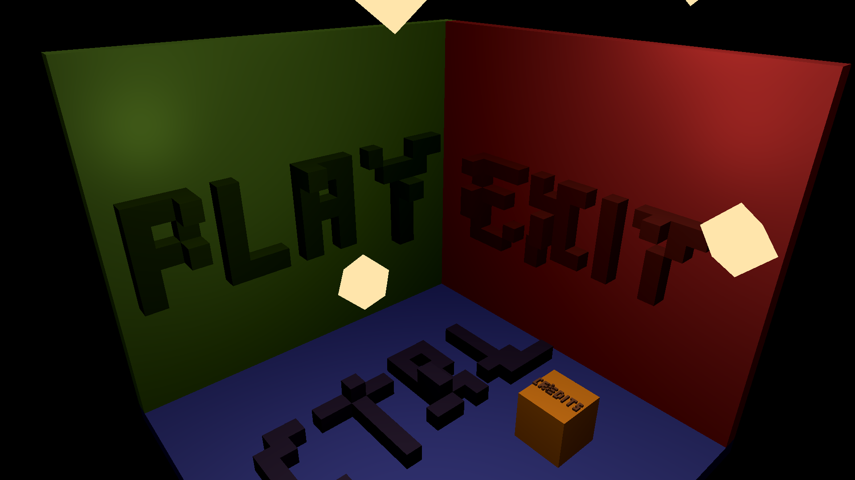
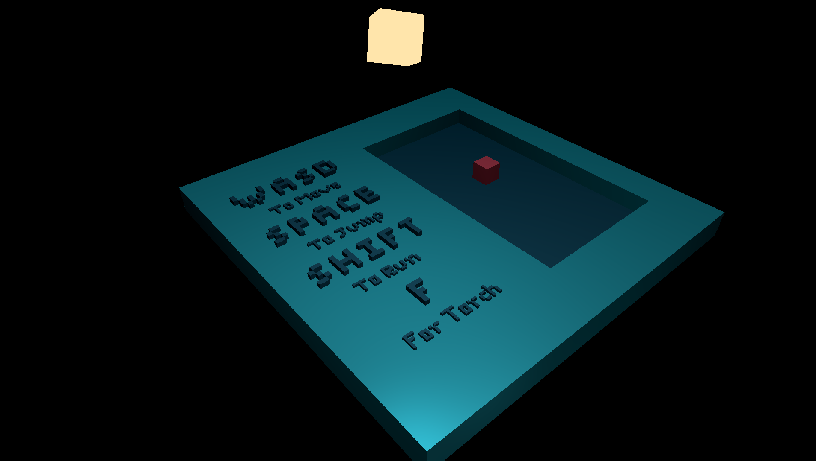
Examples

Slide 91
Audio

Slide 92
Sound Effects Player
Music Player
Sound Device
Audio-related Classes

Slide 93
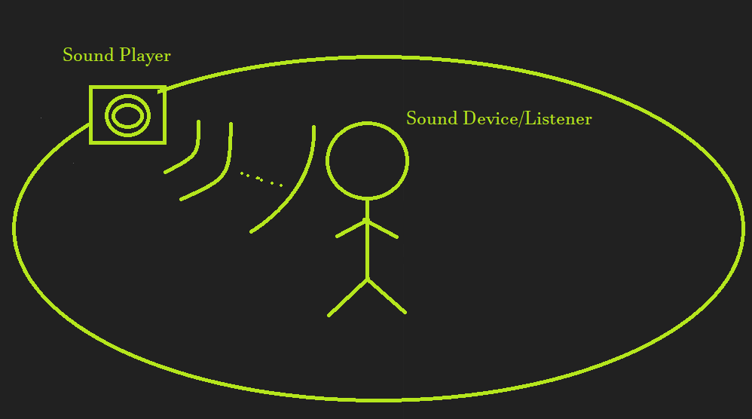
Visual Representation

Slide 94
The Sound Effects Player class aids in loading small buffers while the Music Player cLass is related to loading large buffers.
Sound effects encompass enemy roars, end-pont, and player sprint.
Music relates to background music for the main menu as well as during gameplay.
Sound Effects
and Music Player
Classes

Slide 95
The Sound Device class represents ‘ears’ for your character.
Depending on where the player is standing, the sound volume exponentially decreases or increases.
This also takes into account the player’s orientation resulting in a full 3D audio experience.
Sound Device

Slide 96
Texture Generation

Slide 97
class TexGen
{
private:
static int texlen;
static int ncolor;
static std::mt19937_64 gen64;
static std::vector<int> color_values;
static std::vector<int> ground_prefix_sums;
public:
static std::vector<int> ground();
static std::vector<int> hedge();
static std::tuple<int, int, int> hsv2rgb(std::tuple<int, int, int> hsv);
static void make_ppm(std::vector<int> vec, bool is_hedge);
};
A Sanitized Look at the TexGen Class

Slide 98
#include <random>
...
std::mt19937_64 TexGen::gen64 = []
{
return std::mt19937_64(
std::random_device()());
}();
...
A Source of Randomness

Slide 99
std::vector<int> TexGen::color_values = []
{
// [1, 2, 3, 4, 5, 6, 7, 8, 9, 10, 11, 12, 13, 14, 15, 16]
std::vector<int> values(ncolor);
for (int i = 0; i < ncolor; ++i)
{
values[i] = i + 1;
}
return values;
}();
...
Color Values

Slide 100
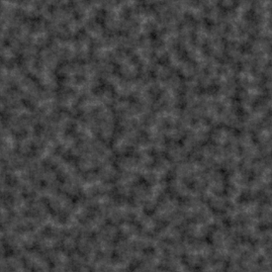
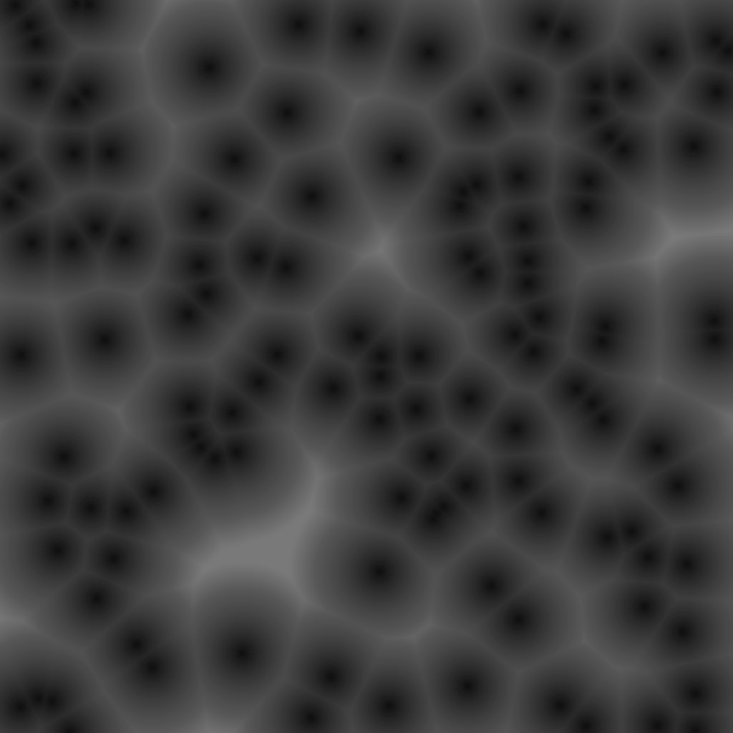
Two Algorithms We Found Most Useful
Value Noise
Best for the Ground Voxels
Worley Noise
Best for the Hedge Voxels

Slide 101
A source of randomness - we already have one using STL, a Mersenne Twister pseudo-random generator of 64-bit numbers
A way to smoothstep values - we simulated normal distribution ourselves for this as the STL version isn’t flexible enough
Coloring each pixel based on the derived values
Value Noise Entails...

Slide 102
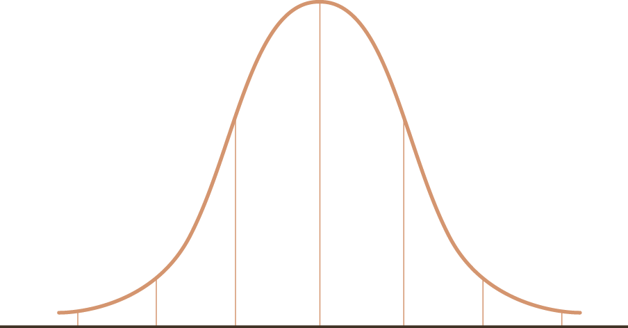
Simulating Normal Distribution
The Weights
std::vector<int> TexGen::ground_prefix_sums = []
{
auto func = [](int n)
{
return std::pow((n), 2);
};
// [1, 4, 9, 16, 25, 36, 49, 64, 64, 49, 36, 25, 16, 9, 4, 1]
std::vector<int> ground_weights(ncolor);
for (int i = 0; i < ncolor / 2; ++i)
{
ground_weights[i] = func(i + 1);
}
for (int i = ncolor / 2; i < ncolor; ++i)
{
ground_weights[i] = ground_weights[ncolor - i];
}
...
}();

Slide 103
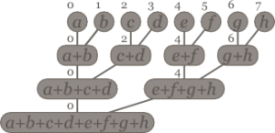
Simulating Normal Distribution
The Prefix Sums
std::vector<int> TexGen::ground_prefix_sums = []
{
...
// [1, 5, 14, 30, 55, 91, 140, 204, 268, 317, 353, 378, 394, 403, 407, 408]
std::vector<int> prefix_sums = ground_weights;
for (int i = 1; i < prefix_sums.size(); ++i)
{
prefix_sums[i] += prefix_sums[i - 1];
}
return prefix_sums;
}();

Slide 104
Simulating Normal Distribution
Find the Ceiling
Array containing color values:
[... 4, 5, 6, 7, ...]
Array containing prefix sums:
[... 30, 55, 91, 140, ...]
In summary, find_ceil() when n == 88 will lead us to a color value of 5.
// binary search-like algo to find ceiling
auto find_ceil = [](int n, int l, int r, std::vector<int> v)
{
while (l < r)
{
int mid = (l + r) / 2;
if (n > v[mid])
{
l = mid + 1;
}
else
{
r = mid;
}
}
return l;
};

Slide 105

Wrapping up the Final Function
Value Noise Result
std::vector<int> TexGen::ground()
{
std::vector<int> generated_texture(texlen * texlen);
std::uniform_int_distribution<int> dist(ground_prefix_sums[0], ground_prefix_sums[ground_prefix_sums.size() - 1]);
for (int i = 0; i < generated_texture.size(); ++i)
{
const auto random_num = dist(gen64);
int left = 0;
int right = ground_prefix_sums.size() - 1;
int ceiling = find_ceil(random_num, left, right, ground_prefix_sums);
generated_texture[i] = color_values[ceiling];
}
return generated_texture;
}

Slide 106
A source of randomness - same as before
Selection of a fixed set of random points in the texture - generated uniformly using our generator
Calculation of the distance between each point in our texture and each of the selected random points
Coloring each pixel based on the minimum of these distances - we tweaked this to use the second minimum distance and used std::nth_element which is O(n) instead of std::sort which O(n log n)
Worley Noise Entails...

Slide 107
Wrapping up the Final Function
Select Points
auto select_points_at_random = [](const int texlen, std::mt19937_64 &gen64)
{
int nbox = std::sqrt(texlen);
std::uniform_int_distribution<int> dist(0, nbox - 1);
std::vector<std::pair<int, int>> random_points(texlen);
// generating a fixed set of random points
for (int i = 0; i < random_points.size(); ++i)
{
random_points[i].first = (i % nbox) * nbox + dist(gen64);
random_points[i].second = (i / nbox) * nbox + dist(gen64);
}
return random_points;
};

Slide 108
Wrapping up the Final Function
Calculate Distances
auto calculate_distances = [](const int i, const int texlen, const std::vector<std::pair<int, int>> &random_points)
{
std::vector<std::vector<int>> distances(texlen * texlen, std::vector<int>(random_points.size()));
for (int j = 0; j < random_points.size(); ++j)
{
// calculating distance for each previously selected point
distances[i][j] = std::hypot(random_points[j].first - i % texlen, random_points[j].second - i / texlen);
}
return distances;
};

Slide 109
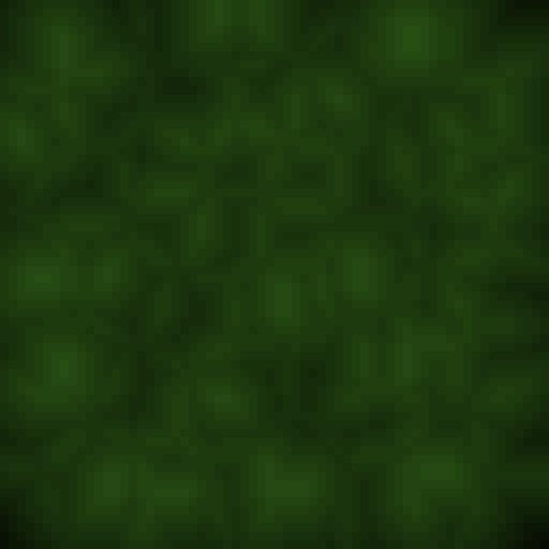
Wrapping up the Final Function
Worley Noise Result
std::vector<int> TexGen::hedge()
{
std::vector<int> generated_texture(texlen * texlen);
auto random_points = select_points_at_random(texlen, gen64);
// calculating distances for each point in the texture
for (int i = 0; i < generated_texture.size(); ++i)
{
auto distances = calculate_distances(i, texlen, random_points);
// sorting only one element in O(n)
std::nth_element(distances[i].begin(), distances[i].begin() + 1, distances[i].end());
generated_texture[i] = (distances[i][1] % ncolor);
}
return generated_texture;
}

Slide 110
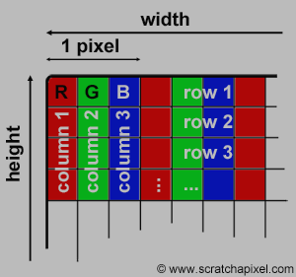
Some Miscellaneous Methods
PPM Exporter
void TexGen::make_ppm(std::vector<int> vec, bool is_hedge)
{
const int width = TexGen::texlen;
const int height = TexGen::texlen;
std::string filename = "";
int h, s, v;
// we use the PPM file format for convenience
std::ofstream image(filename, std::ofstream::binary);
image << "P3" << '\n';
image << width << ' ' << height << '\n';
image << "255" << '\n';
for (int i = 0; i < height * width; i++)
{
int h2 = h;
int s2 = s;
int v2 = v - vec[i];
auto [r, g, b] = hsv2rgb(std::make_tuple(h2, s2, v2));
image << r << ' ' << g << ' ' << b << '\n';
}
}

Slide 111
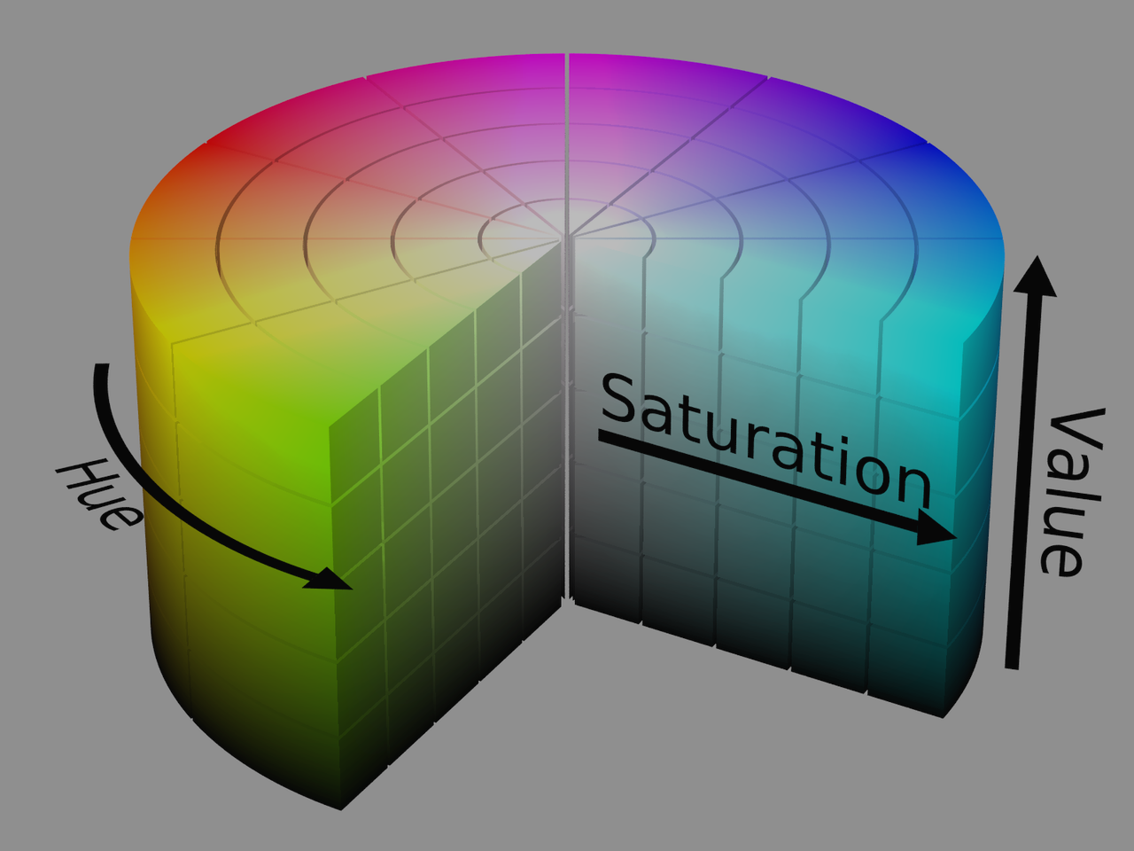
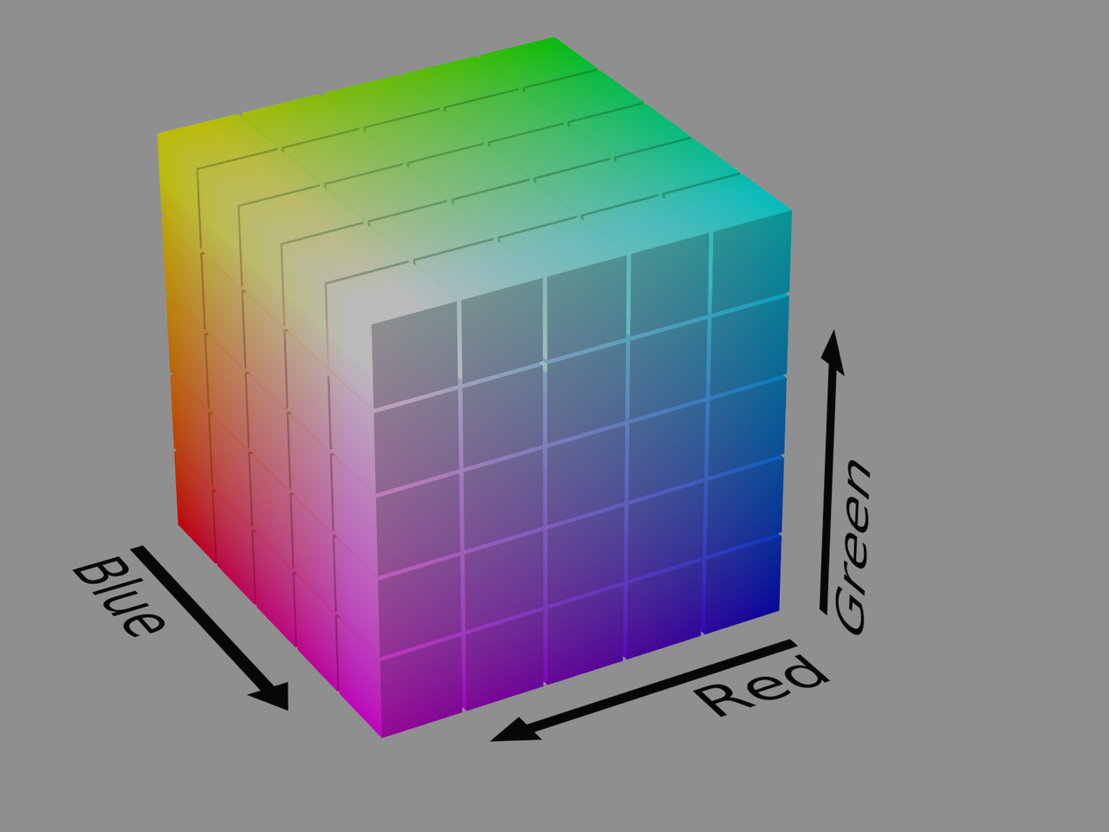
Some Miscellaneous Methods
HSV to RGB
// https://en.wikipedia.org/wiki/HSL_and_HSV#HSV_to_RGB
std::tuple<int, int, int> TexGen::hsv2rgb(std::tuple<int, int, int> hsv)
{
auto [h, s, v] = hsv;
double H = h / 60.0;
double S = s / 100.0;
double V = v / 100.0;
double C = V * S;
double X = C * (1.0 - std::abs(std::fmod(H, 2.0) - 1.0));
double M = V - C;
double R, G, B;
if (0 <= H && H <= 1)
{
...
}
...
else if (5 < H && H <= 6)
{
...
}
int r = (R + M) * 255.0;
int g = (G + M) * 255.0;
int b = (B + M) * 255.0;
return {r, g, b};
}

Slide 112
Thank you for your attention.
We hope you liked our project.

